Slide 1
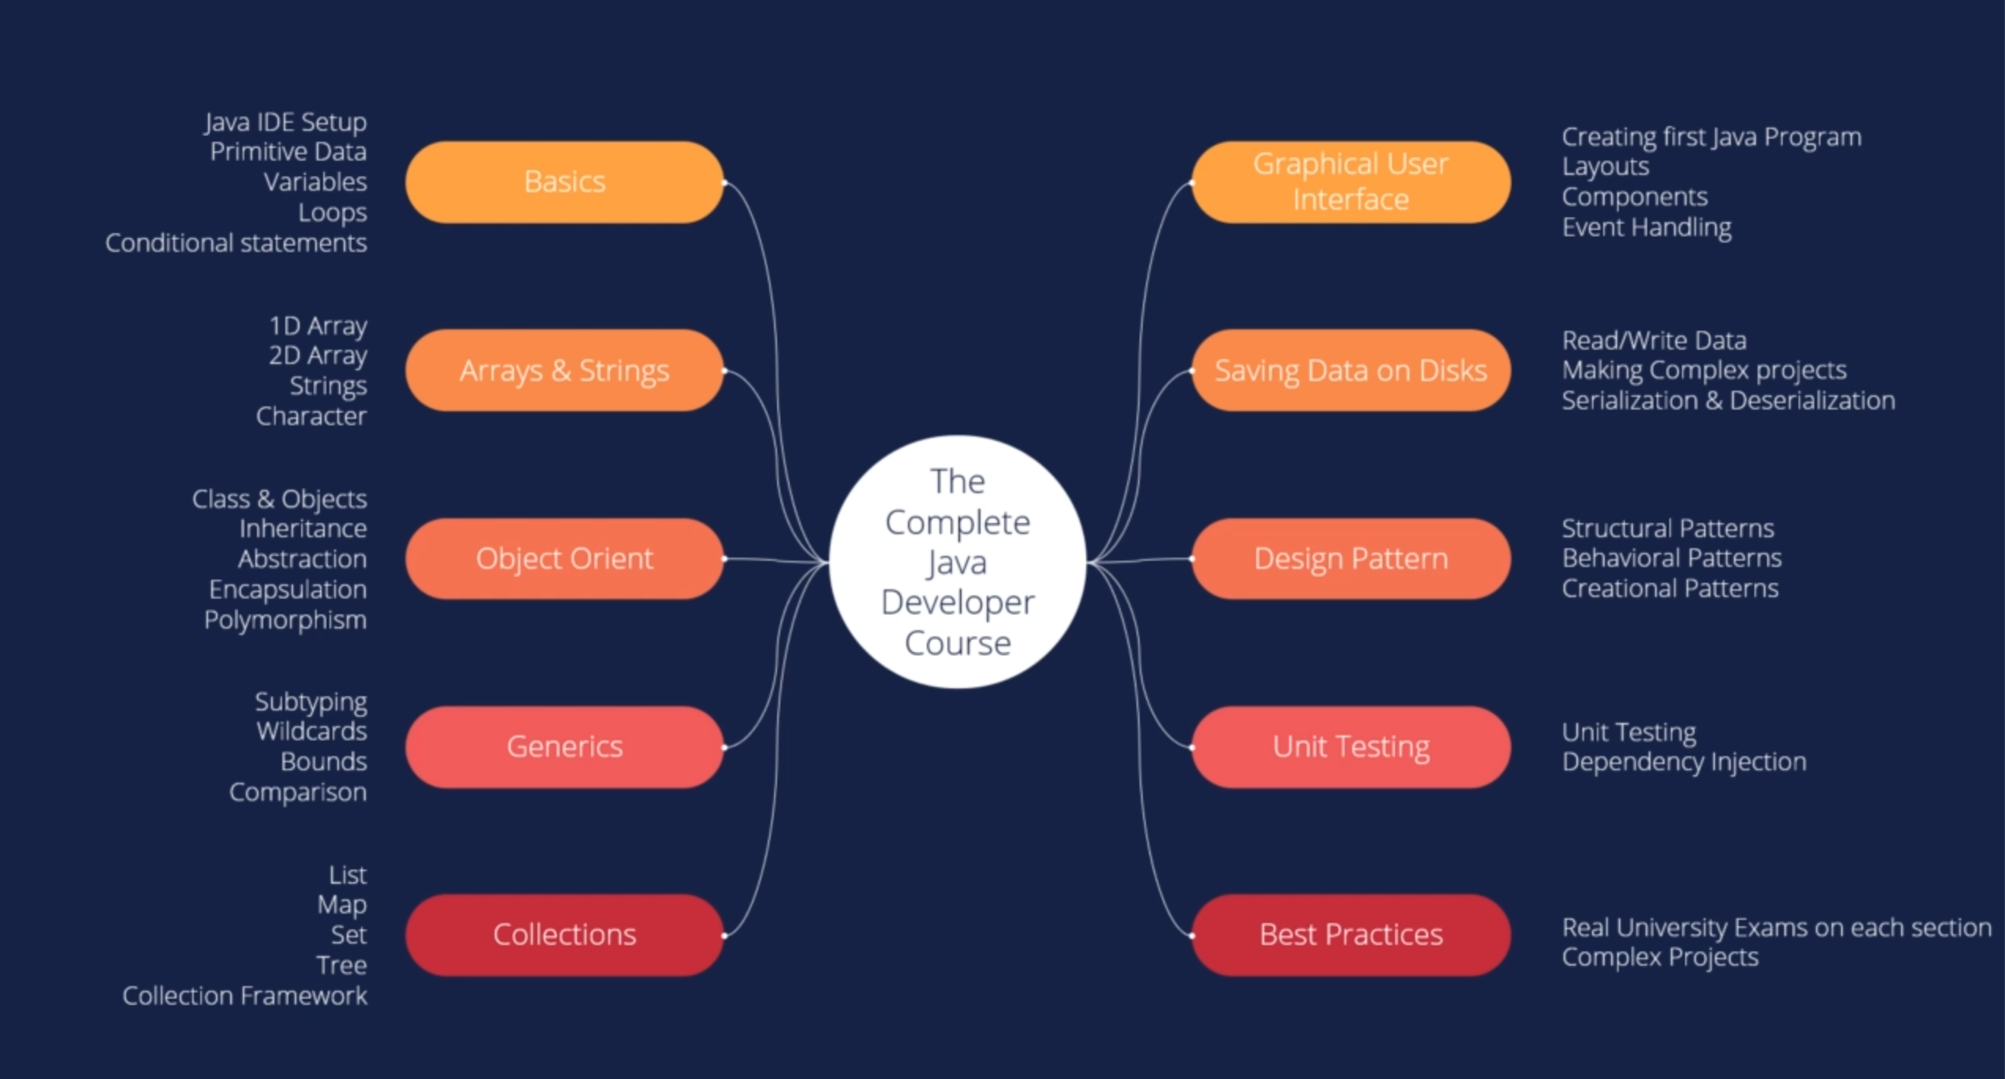

Slide 2
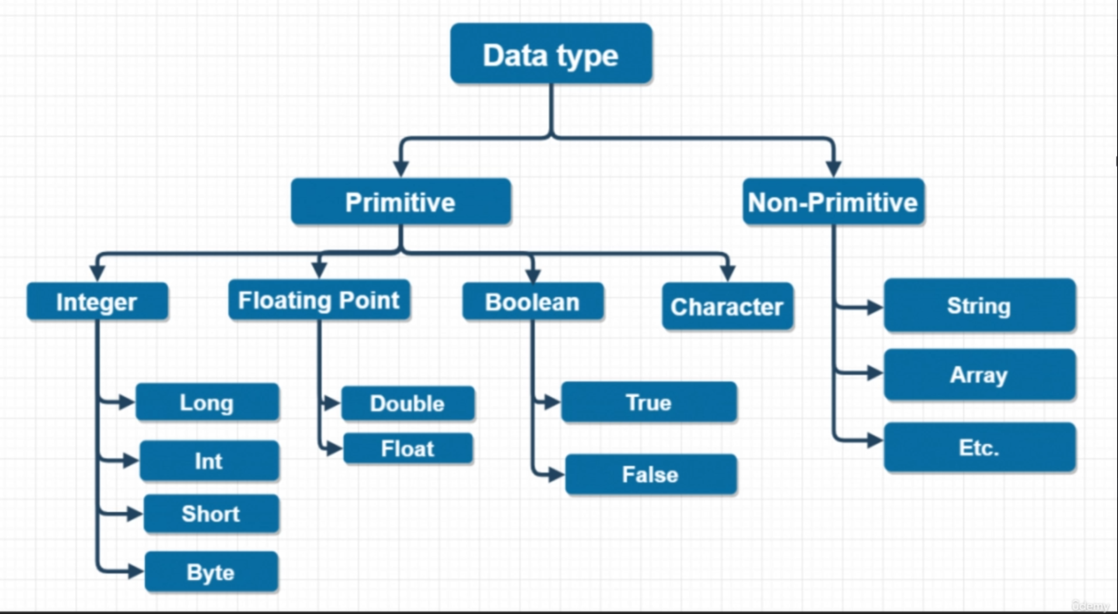

Slide 3
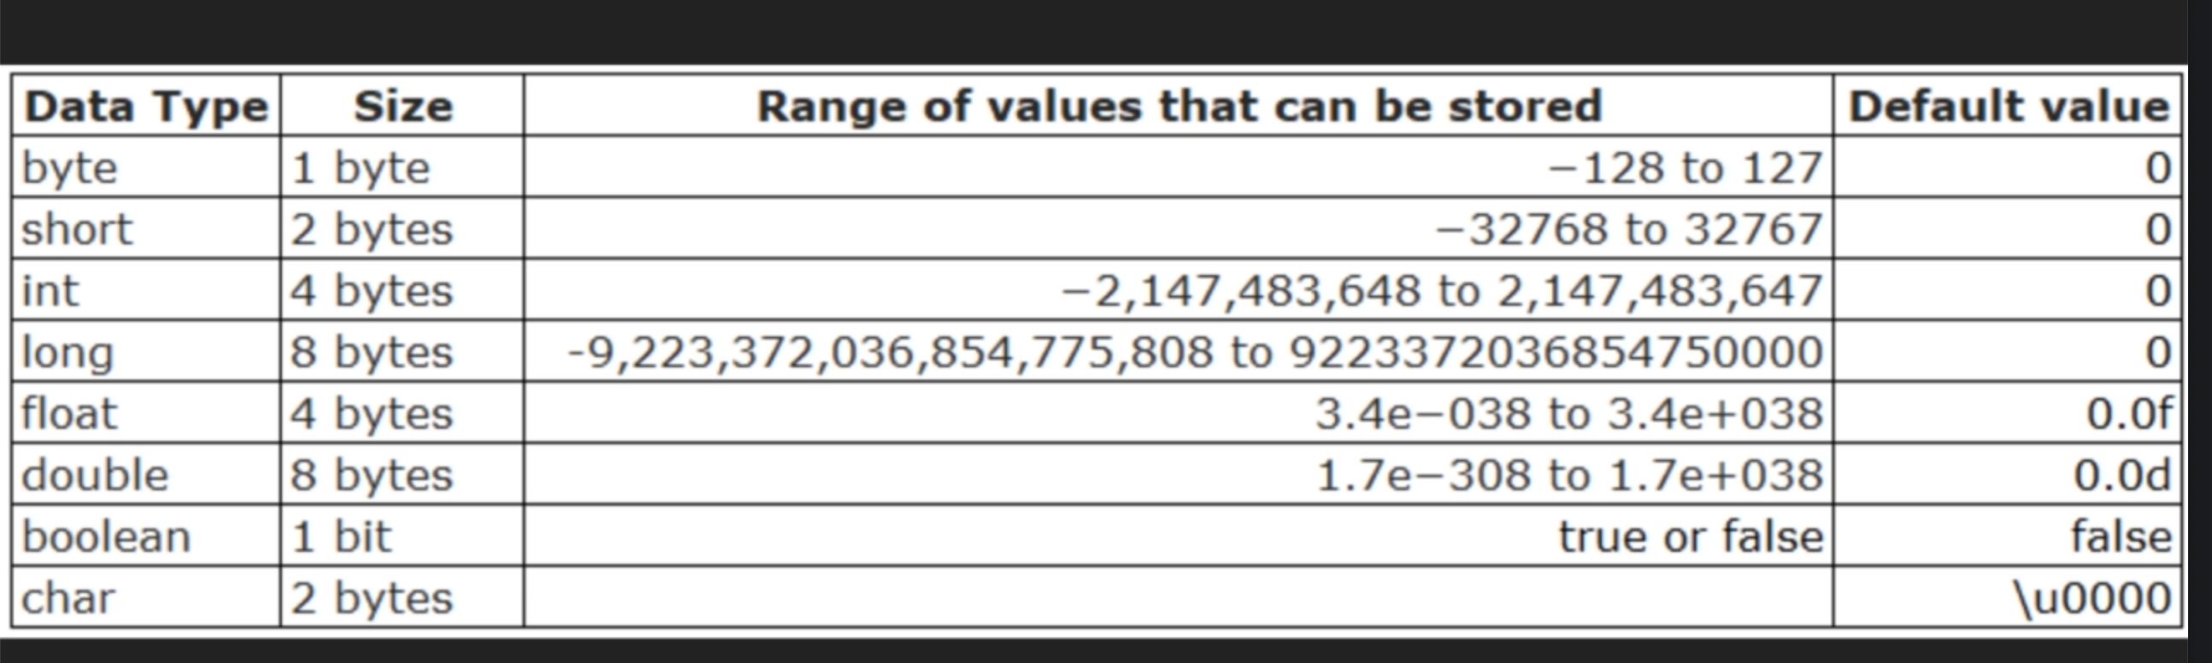

Slide 4
Java code challenge
Convert Temperature from Celsius to Fahrenheit: Write a Java program that takes a temperature value in Celsius as input and converts it to Fahrenheit.
The formula for converting Celsius to Fahrenheit is: F = (C × 9/5) + 32, where F is the temperature in Fahrenheit and C is the temperature in Celsius.

Slide 5
Java code challenge
Write a java program that allow the user to enter his weight and height, and display the body mass index for the user
The formular is BMI = kg/m2
Where kg = persons weight
m = persons height in meter.

Slide 6
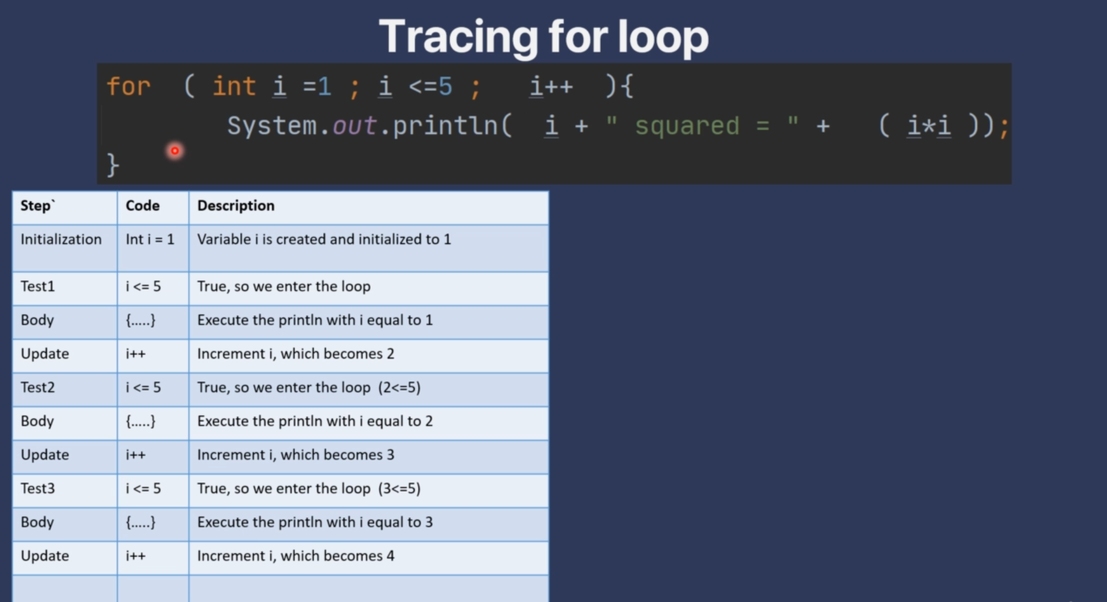

Slide 7
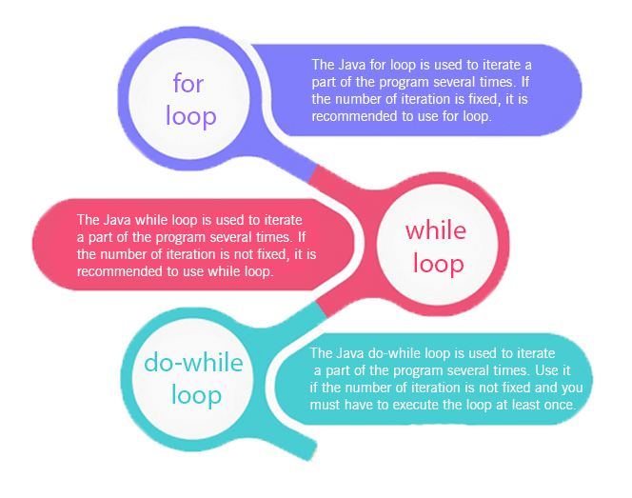
Loops in Java
The Java for loop is used to iterate a part of the program several times. If the number of iteration is fixed, it is recommended to use for loop.
There are three types of for loops in Java

Slide 8
Java Simple for Loop
A simple for loop is the same as C/C++. We can initialize the variable, check condition and increment/decrement value. It consists of four parts:
Initialization: It is the initial condition which is executed once when the loop starts. Here, we can initialize the variable, or we can use an already initialized variable. It is an optional condition.
Condition: It is the second condition which is executed each time to test the condition of the loop. It continues execution until the condition is false. It must return boolean value either true or false. It is an optional condition.
Increment/Decrement: It increments or decrements the variable value. It is an optional condition.
Statement: The statement of the loop is executed each time until the second condition is false.
Reference Material
https://www.javatpoint.com/java-for-loop

